Slide 1
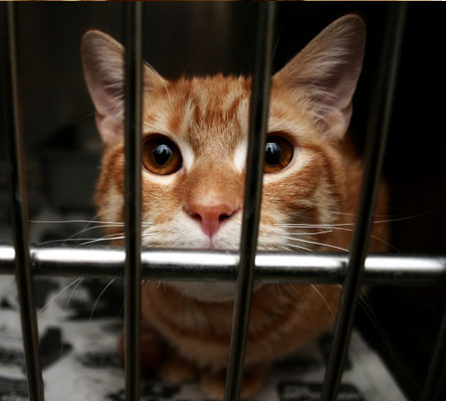
Color
Breed
Age
Time
Neutering
Sex

